Slide 1

Visualization and Analysis – Tutorial Presentation for Feedback
Research Question: Template 3: "Is there a difference in the proportions of employment status (placed vs. not placed) between male and female students?"
Date : 18 November 2024
Group Name: Campus Recruitment Name of Student Presenting: S M Mahamudul Hasan

Slide 2
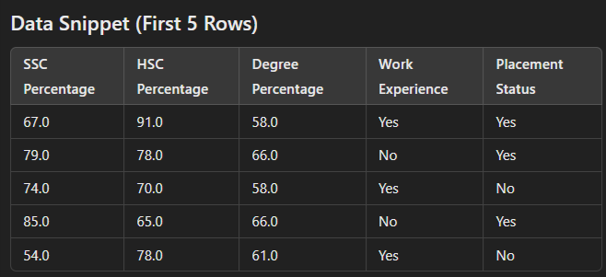
Selected Columns/Variables
The research question focuses on predicting placement certainty. Some Key Columns:
SSC Percentage: The percentage scored by the student in Secondary School Certificate (SSC).
HSC Percentage: The percentage scored by the student in Higher Secondary Certificate (HSC).
Degree Percentage: percentage obtained in their undergraduate degree.
Work Experience: Whether the student has prior work experience (yes/no).
Placement Status: Indicates if the student was placed or not (Yes/No).
Dataset Overview
Dataset Name: DS331 Placement_Data_Full_Class
Row Count: 215
Column Count: 15
Null Values: Only the salary column contains null values, with a total of 67 missing entries. All other columns have no missing values.

Slide 3
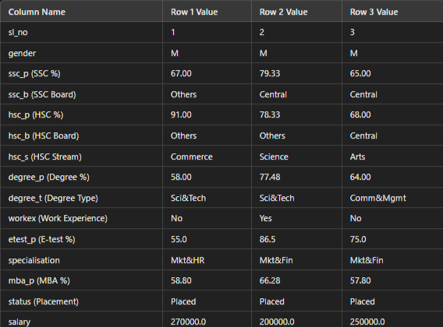
01. sl_no ==> Serial Number
02. Gender- Male='M',Female='F'
03. ssc_p ==> Secondary Education percentage- 10th Grade
04. ssc_b ==> Board of Education- Central/ Others
05. hsc_p ==> Secondary Education percentage- 10th Grade
06. hsc_b ==> Board of Education- Central/ Others
07. hsc_s ==> Specialization in Higher Secondary Education
08. degree_p ==> Degree Percentage
09. degree_t ==> Under Graduation(Degree type)- Field of degree education
10. workex ==> Work Experience
11. etest_p ==> Employability test percentage ( conducted by college)
12. specialisation ==> Post Graduation(MBA)- Specialization
13. mba_p ==> MBA percentage
14. status ==> Status of placement- Placed/Not placed
15. salary ==> Salary offered by corporate to candidates

Slide 4
This dataset is interesting to us because (one sentence):
It provides a comprehensive view of student performance metrics and experience, allowing us to explore potential predictors of job placement success.
Dataset ID : DS331- Placement_Data_Full_Class
Variable | Type | Description
Independent Variable | Gender | Reason: Gender is chosen to examine if there is a difference in placement outcomes between male and female students. This analysis could provide insights into any potential gender-based trends or disparities in placement. Datatype: Nominal/Categorical – Gender is a categorical variable with distinct categories (e.g., Male, Female).
Dependent Variable | Placement Status | Reason: This is the outcome variable, indicating whether a student was successfully placed or not. Datatype: Nominal/categorical (as it has distinct categories: "Placed" or "Not Placed").
Notes:
Before specifying your Research Question you must define the type of data you are analysing. Are the variables you select interval data (measurement data you can divide, multiple, etc), OR are they ordinal (there is a definite order but the intervals between each variable are not necessarily equal, or the terms might be subjective like in a likert scale); OR are they just categorical/nominal (Items such as film names, cities, etc., that you can count numbers of occurrences? You also need to understand whether the variable is either dependent or independent and this will vary according to the context. Independent variables may cause an effect, whereas the dependent variable might be affected by the independent variable. Check the lecture notes on the RQ for more information and examples.
You will get only one opportunity to present your Research Question ahead of the submission date. Have your questions ready, and be ready to take notes on feedback.

Slide 5
whether there is a significant association between gender and placement status, indicating if placement rates differ between male and female students.
Hypothesis :
Null Hypothesis (H₀):
There is no difference in the proportions of employment status (placed vs. not placed) between male and female students.
Alternative Hypothesis (H₁): There is a difference in the proportions of employment status (placed vs. not placed) between male and female students.
.
Notes:
Before specifying your Research Question you must define the type of data you are analysing. Are the variables you select interval data (measurement data you can divide, multiple, etc), OR are they ordinal (there is a definite order but the intervals between each variable are not necessarily equal, or the terms might be subjective like in a likert scale); OR are they just categorical/nominal (Items such as film names, cities, etc., that you can count numbers of occurrences? You also need to understand whether the variable is either dependent or independent and this will vary according to the context. Independent variables may cause an effect, whereas the dependent variable might be effected by the independent variable. Check the lecture notes on the RQ for more information and examples.
You will get only one opportunity to present your Research Question ahead of the submission date. Have your questions ready, and be ready to take notes on feedback.

Slide 6
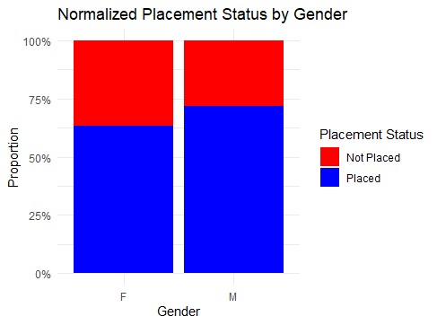
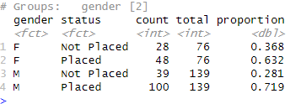
.
Visualisation of stacked Bar chart with Normalized
Notes:
Before specifying your Research Question you must define the type of data you are analysing. Are the variables you select interval data (measurement data you can divide, multiple, etc), OR are they ordinal (there is a definite order but the intervals between each variable are not necessarily equal, or the terms might be subjective like in a likert scale); OR are they just categorical/nominal (Items such as film names, cities, etc., that you can count numbers of occurrences? You also need to understand whether the variable is either dependent or independent and this will vary according to the context. Independent variables may cause an effect, whereas the dependent variable might be affected by the independent variable. Check the lecture notes on the RQ for more information and examples.
You will get only one opportunity to present your Research Question ahead of the submission date. Have your questions ready, and be ready to take notes on feedback.

Slide 7
To provide a thorough analysis based on your research question—Is there a difference in the proportions of placement status (placed vs. not placed) between male and female students?—we will perform a Chi-Square Test and present the results as per your requirements.
.
Our evaluation process:
01. Calculate Test Statistic
02. Value of the Test Statistic
03. P-Value detection
04. Is the result significant?
05. Accept or Reject the Null Hypothesis
If the result is significant (p<0.05):
Interpretation: Gender has a significant relationship with placement status. This means that placement proportions vary between male and female students.
Application: This insight can guide targeted placement programs or interventions to address any imbalances.
If the result is not significant (p > 0.05):
Interpretation: Gender does not influence placement status. The proportions are similar across genders.
Application: Efforts can focus on other factors influencing placement rather than gender.
.
Notes:
Before specifying your Research Question you must define the type of data you are analysing. Are the variables you select interval data (measurement data you can divide, multiple, etc), OR are they ordinal (there is a definite order but the intervals between each variable are not necessarily equal, or the terms might be subjective like in a likert scale); OR are they just categorical/nominal (Items such as film names, cities, etc., that you can count numbers of occurrences? You also need to understand whether the variable is either dependent or independent and this will vary according to the context. Independent variables may cause an effect, whereas the dependent variable might be effected by the independent variable. Check the lecture notes on the RQ for more information and examples.
You will get only one opportunity to present your Research Question ahead of the submission date. Have your questions ready, and be ready to take notes on feedback.

Slide 8
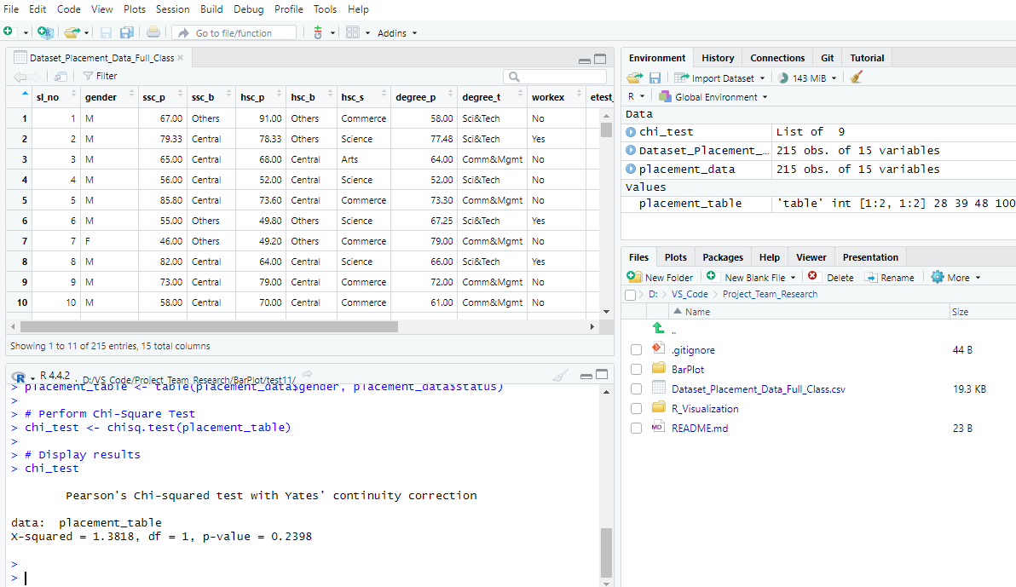
.
.
.
Notes:
Before specifying your Research Question you must define the type of data you are analysing. Are the variables you select interval data (measurement data you can divide, multiple, etc), OR are they ordinal (there is a definite order but the intervals between each variable are not necessarily equal, or the terms might be subjective like in a likert scale); OR are they just categorical/nominal (Items such as film names, cities, etc., that you can count numbers of occurrences? You also need to understand whether the variable is either dependent or independent and this will vary according to the context. Independent variables may cause an effect, whereas the dependent variable might be effected by the independent variable. Check the lecture notes on the RQ for more information and examples.
You will get only one opportunity to present your Research Question ahead of the submission date. Have your questions ready, and be ready to take notes on feedback.

Slide 9
To provide a thorough analysis based on your research question—Is there a difference in the proportions of placement status (placed vs. not placed) between male and female students?—we will perform a Chi-Square Test and present the results as per your requirements.
.
P value:
01. P value is shown as chi_Test$p.value
02. Determine whether its greater or less than 0.05:
if p<0.05 the result is significant.
if p> 0.05 the result is not significant.
Is the result Significant?
- Here p>0.05 . Indicating that there is no statistically significant difference in placement proportions between genders.
.
Notes:
Before specifying your Research Question you must define the type of data you are analysing. Are the variables you select interval data (measurement data you can divide, multiple, etc), OR are they ordinal (there is a definite order but the intervals between each variable are not necessarily equal, or the terms might be subjective like in a likert scale); OR are they just categorical/nominal (Items such as film names, cities, etc., that you can count numbers of occurrences? You also need to understand whether the variable is either dependent or independent and this will vary according to the context. Independent variables may cause an effect, whereas the dependent variable might be effected by the independent variable. Check the lecture notes on the RQ for more information and examples.
You will get only one opportunity to present your Research Question ahead of the submission date. Have your questions ready, and be ready to take notes on feedback.

Slide 10
To provide a thorough analysis based on your research question—Is there a difference in the proportions of placement status (placed vs. not placed) between male and female students?—we will perform a Chi-Square Test and present the results as per your requirements.
.
Analysis of Results:
Test Statistic: X-squared = 1.3818, df = 1
p-value = 0.2398 (greater than 0.05)
Significance: The result is not significant.
Conclusion: Accept the null hypothesis. Gender has no impact on placement status.
.
Notes:
Before specifying your Research Question you must define the type of data you are analysing. Are the variables you select interval data (measurement data you can divide, multiple, etc), OR are they ordinal (there is a definite order but the intervals between each variable are not necessarily equal, or the terms might be subjective like in a likert scale); OR are they just categorical/nominal (Items such as film names, cities, etc., that you can count numbers of occurrences? You also need to understand whether the variable is either dependent or independent and this will vary according to the context. Independent variables may cause an effect, whereas the dependent variable might be effected by the independent variable. Check the lecture notes on the RQ for more information and examples.
You will get only one opportunity to present your Research Question ahead of the submission date. Have your questions ready, and be ready to take notes on feedback.

